Slide 1
Hadoop WordCount example

Slide 2
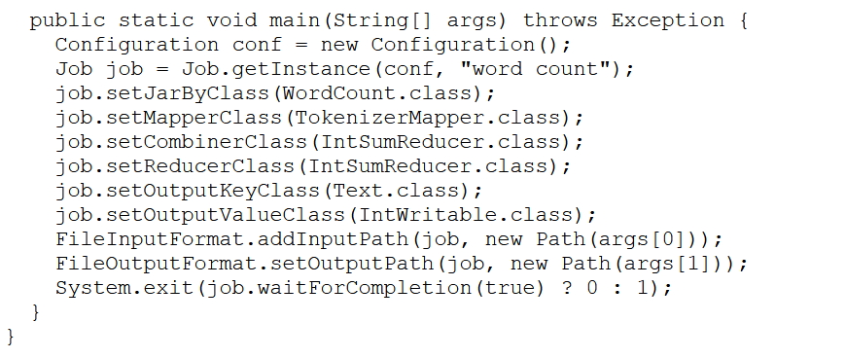

Slide 3
Input file
Hello World Bye World
Hello Hadoop Goodbye Hadoop

Slide 4
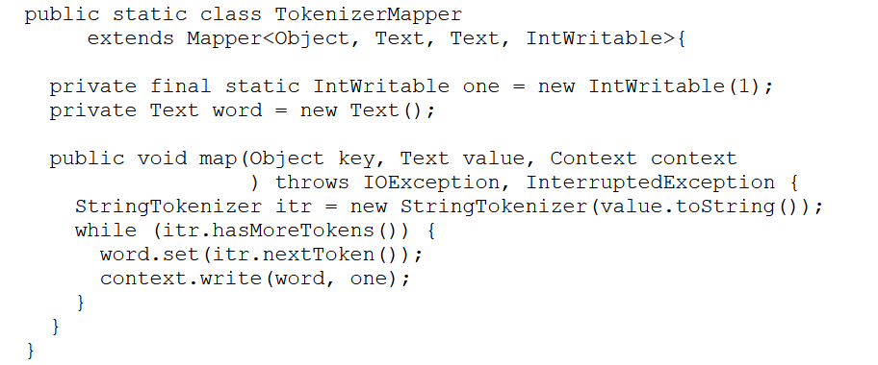
Hello World Bye World
Hello Hadoop Goodbye Hadoop
Hello
World
Bye
World
Pass this key value pair to reducer function

Slide 5
Ouput of Mapper
< Hello, 1>
< World, 1>
< Bye, 1>
< World, 1>
< Hello, 1>
< Hadoop, 1>
< Goodbye, 1>
< Hadoop, 1>
< Hello, 1>
< Bye, 1>
< World, 2>
< Hello, 1>
< Goodbye, 1>
< Hadoop, 2>
< Hello, [1,1]>
< Bye, [1]>
< World, [2]>
< Goodbye, [1]>
< Hadoop, [2]>
Local aggregation
Global aggregation

Slide 6
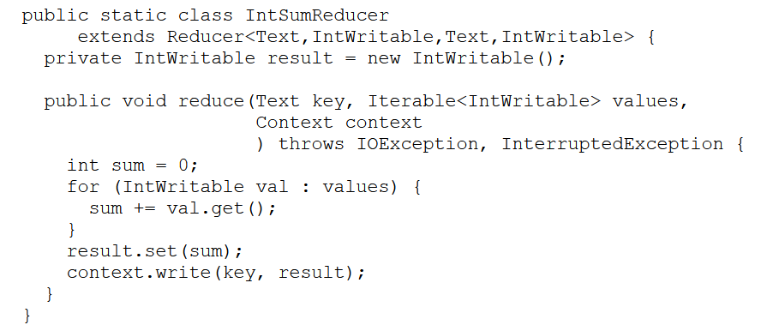
< Hello, [1,1]>
< Bye, [1]>
< World, [2]>
< Goodbye, [1]>
< Hadoop, [2]>
Output written to file in output folder

Slide 7
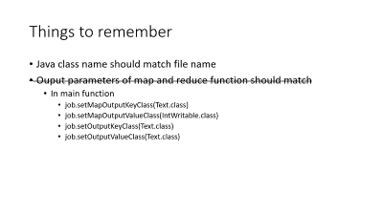
Ouput file
Bye 1
Goodbye 1
Hadoop 2
Hello 2
World 2

Slide 8
Things to remember
Java class name should match file name
Ouput parameters of map and reduce function should match
In main function
job.setMapOutputKeyClass(Text.class)
job.setMapOutputValueClass(IntWritable.class)
job.setOutputKeyClass(Text.class)
job.setOutputValueClass(Text.class)

